Slide 1
Data Analysis 2 (python)
Data Wrangling and Data Aggregation
For any questions reach out to: kim.ta@barclays.com

Slide 2
Contents
Set-up
Filtering data
By a single condition
By multiple conditions
Using isin()
Using between()
Reshaping data
Pivoting Data
Melting Data
Transposing Data
Group by and Aggregation
Random sampling
Joins

Slide 3
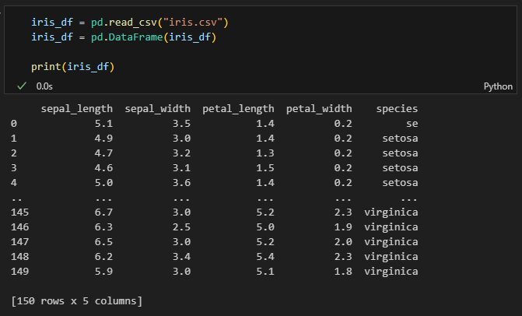
Set-up
Import the necessary libraries
Load your data
We will be looking at the iris dataset.
This data sets consists of 3 different types of irises’ (Setosa, Versicolour, and Virginica) petal and sepal length, stored in a 150x4 numpy.ndarray
The rows being the samples and the columns being: Sepal Length, Sepal Width, Petal Length and Petal Width.

Slide 4
Filtering the data
Filtering data means selecting rows based on certain conditions. Here we will look at filtering by:
a single condition
multiple conditions
Using isin()
Using between()

Slide 5
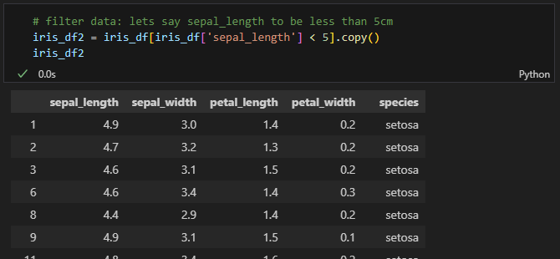
Filter by a single condition

Slide 6
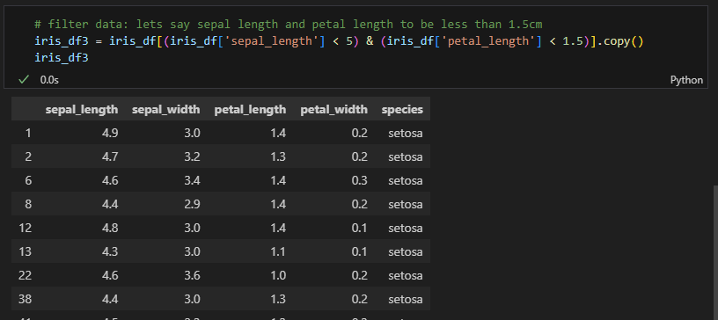
Filter by multiple conditions

Slide 7
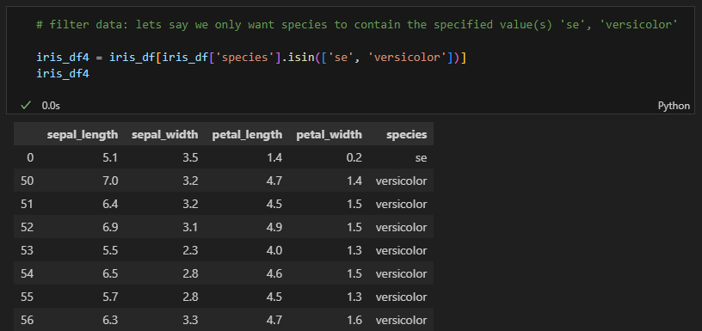
Filter using ‘isin()‘

Slide 8
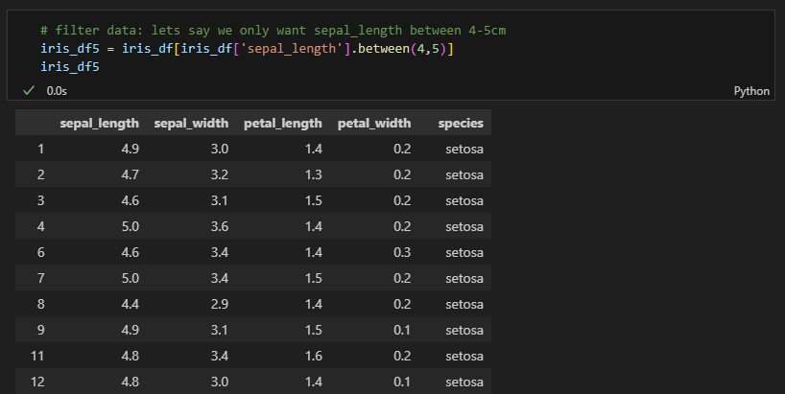
Filter using ‘between()‘

Slide 9
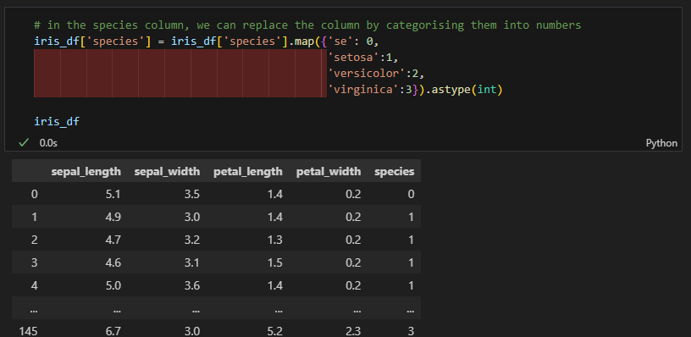
Categorising fields

Slide 10
Reshaping the data
Rearranging the data without altering the content of the dataset
Pivoting Data: reshaping data where you turn unique values from one column into multiple columns
Melting Data: melt function is used to unpivot columns while keeping a column as the identifier variable. It enables us to reshape and elongate the data frames in a user-defined manner. It organizes the data values in a long data frame format.
Transposing Data: To switch rows and columns.

Slide 11
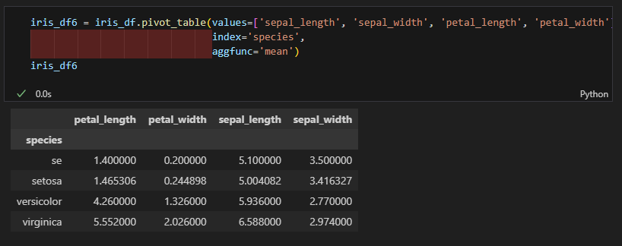
Pivoting data
We use pivot_table to calculate the mean values of the different features for each species. The values parameter specifies the columns to aggregate, index specifies the columns to group by, and aggfunc specifies the aggregation function (in this case, mean).
This pivot operation summarizes the Iris dataset by showing the average measurements of each feature for each species.

Slide 12
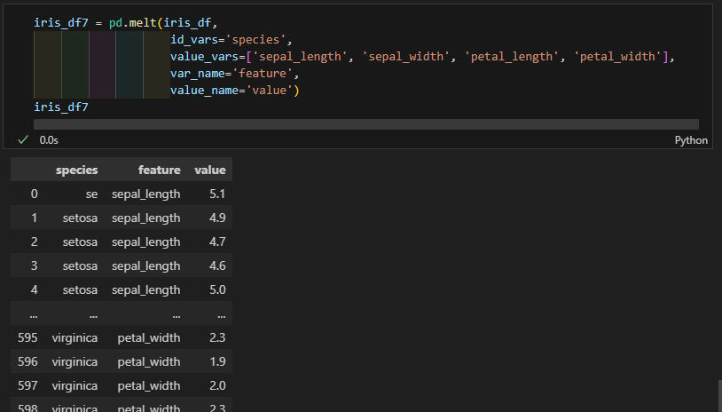
Melting data
The id_vars parameter specifies the column(s) to keep fixed (in this case, 'species'), the value_vars parameter specifies the columns to melt (the measurement columns), var_name specifies the name of the new column that will hold the names of the melted columns, and value_name specifies the name of the new column that will hold the values.
This melt operation reshapes the Iris dataset from a wide format, where each feature has its own column, to a long format, where all the measurements are combined into a single column. This can be useful for various types of data analysis and visualization.

Slide 13
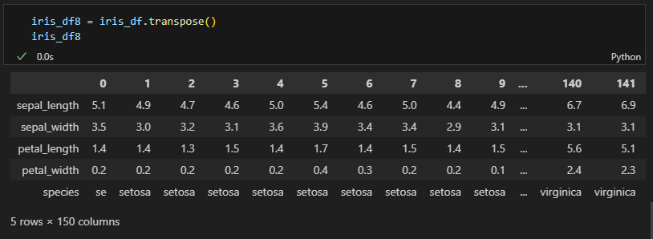
Transpose data
Transposing a DataFrame can be helpful when you need to view data differently, but keep in mind that for datasets like Iris, where data is in a tabular format, transposing may not always be meaningful or practical.

Slide 14
Group by and Aggregation
The GROUP BY clause divides a table into sets. This clause is most often combined with aggregate functions that produce summary values for each of those sets
Using groupby() and agg()
Aggregations sum(), mean(), median(), min(), and max()
Using one value to describe multiple data points, aggregation can be used to get a summary of columns in our dataset.

Slide 15
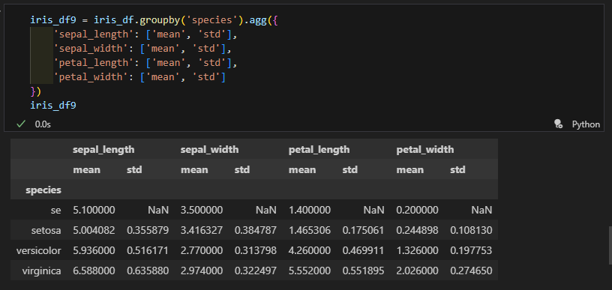
Group by and Aggregation
We use the groupby() function to group the data by the 'species' column. Then, we use the agg() function to apply aggregate functions to each group. In this case, we calculate the mean and standard deviation for each feature.

Slide 16
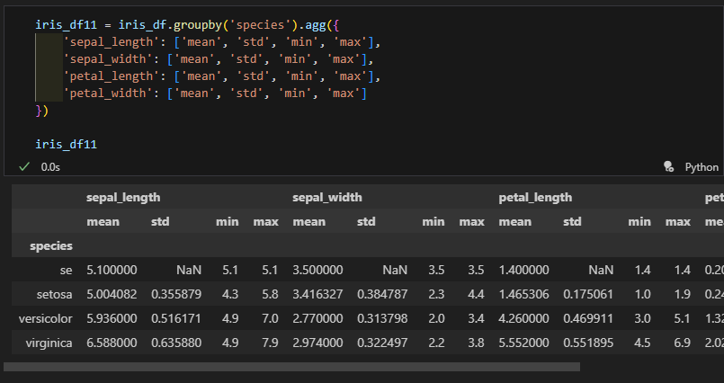
Additional Aggregations
include other statistics such as min, max, sum, median

Slide 17
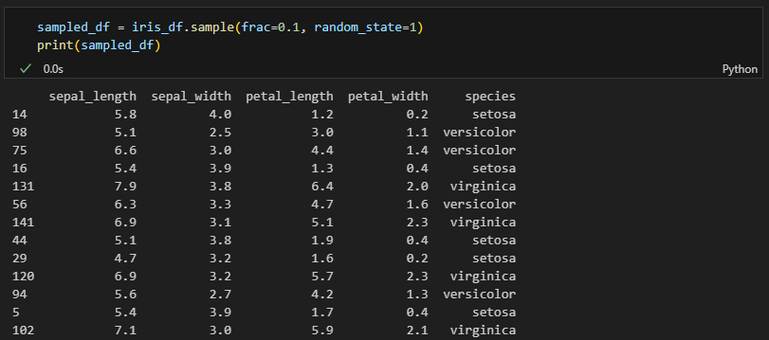
Random Sampling
We use the sample() method to randomly sample rows from the DataFrame. The frac parameter specifies the fraction of rows to return in the random sample, and random_state ensures reproducibility of the sample.

Slide 18
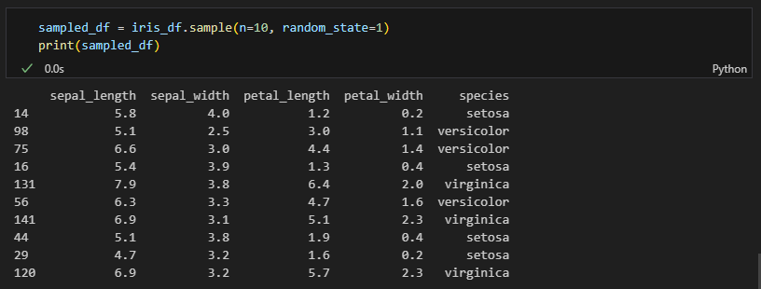
Sample a fixed number of rows
Alternatively, we can specify the number of rows to sample using the n parameter.
Random sampling is a powerful tool for creating subsets of data for analysis, testing, or training models. The random_state parameter ensures that the sampling is reproducible.

Slide 19
Joins
A JOIN clause is used to combine rows from two or more tables, based on a related column between them.
We will be using the Pandas library in Python to perform:
Inner Join
Outer Join (left, right, full)

Slide 20
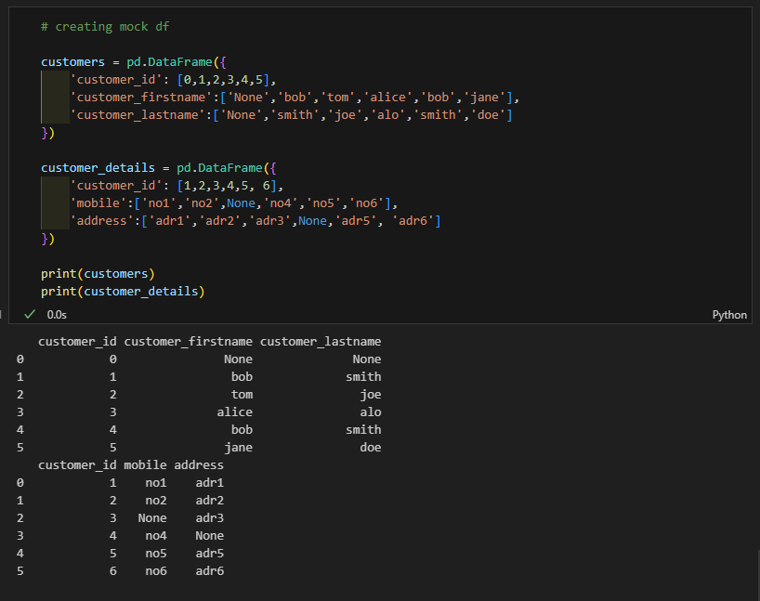

Slide 21
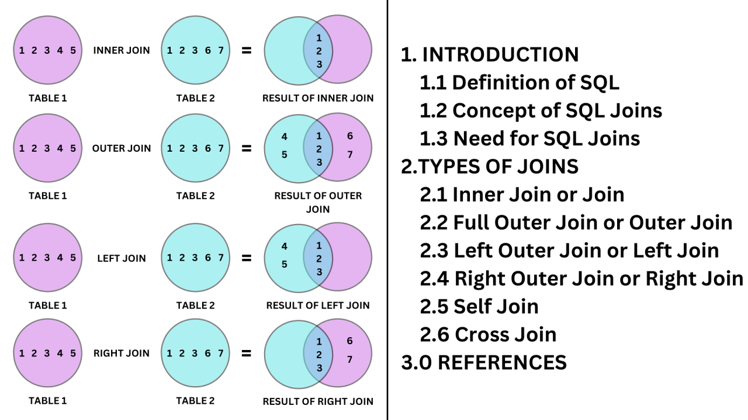
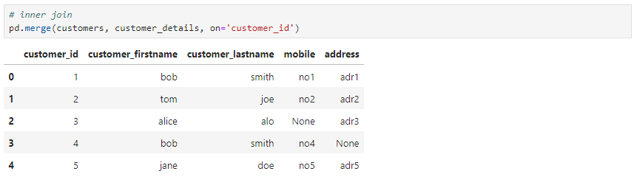
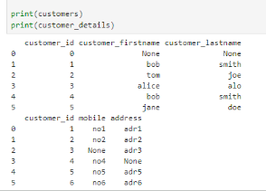
Inner Join

Slide 22
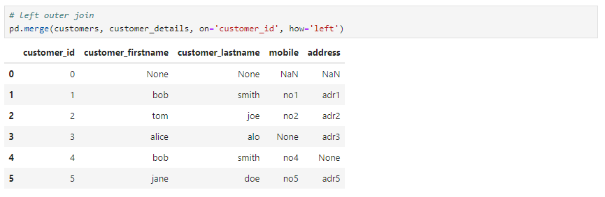
Left Outer Join

Slide 23
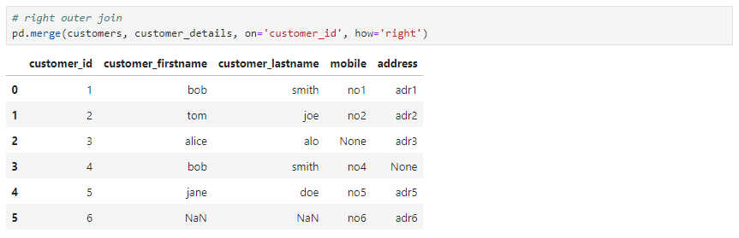
Right Outer Join

Slide 24
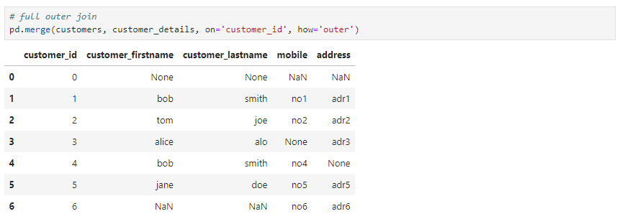
Full Outer Join

Slide 25
